Slide 1
LOGO
DESIGN
ASSIGNMENT

Slide 2
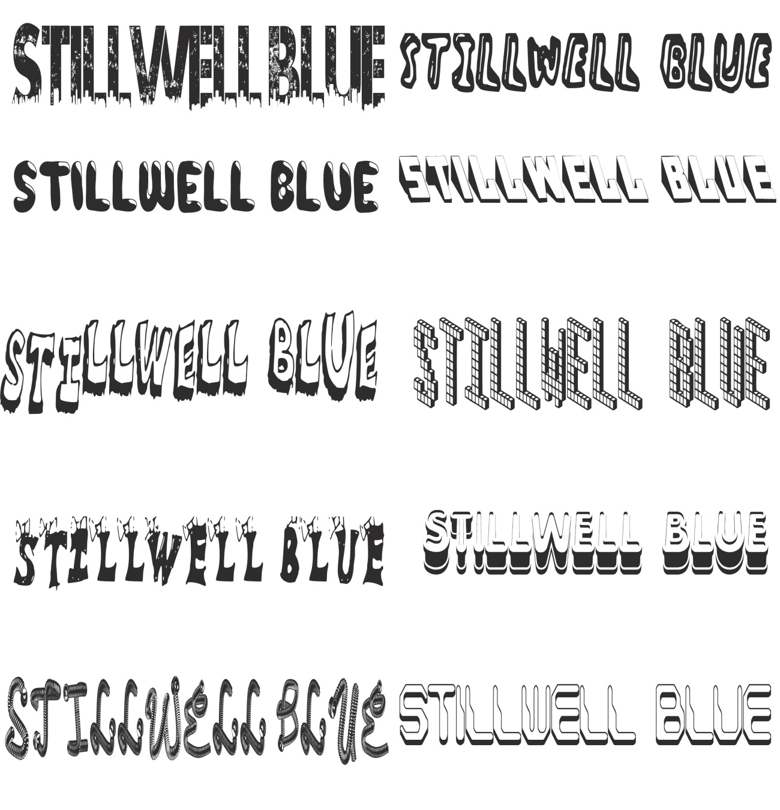
PART ONE (a)

Slide 3
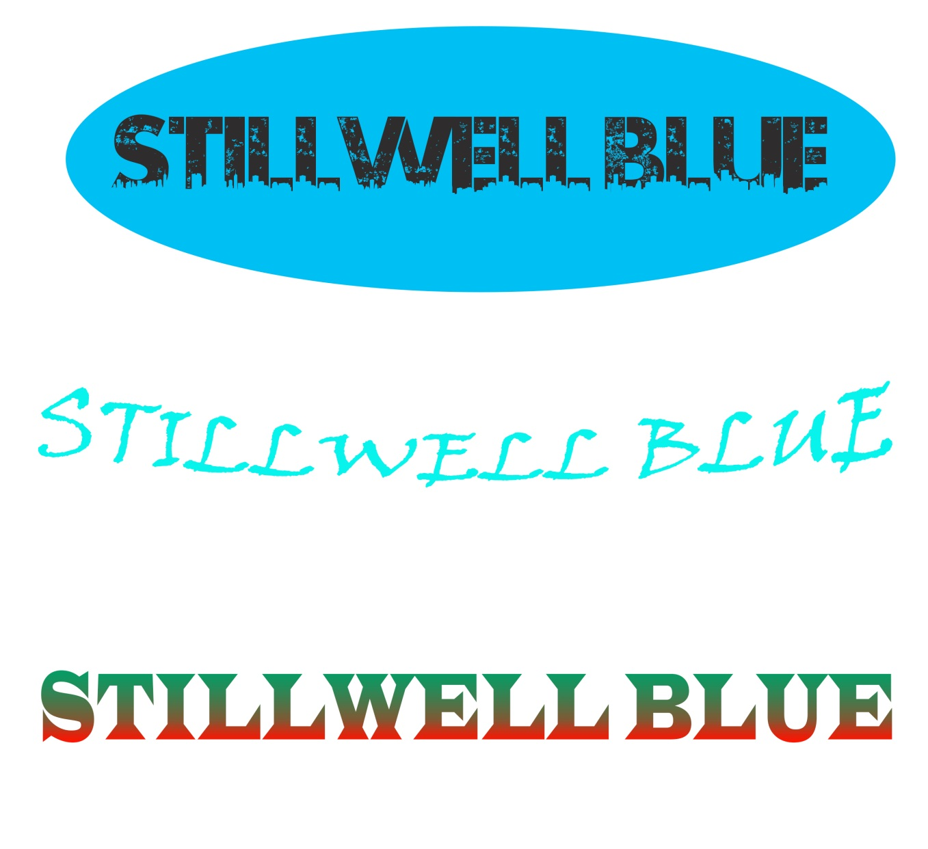
PART ONE (b) VARIATION 1

Slide 4

PART ONE (b) VARIATION 2

Slide 5

PART ONE (b) VARIATION 3

Slide 6
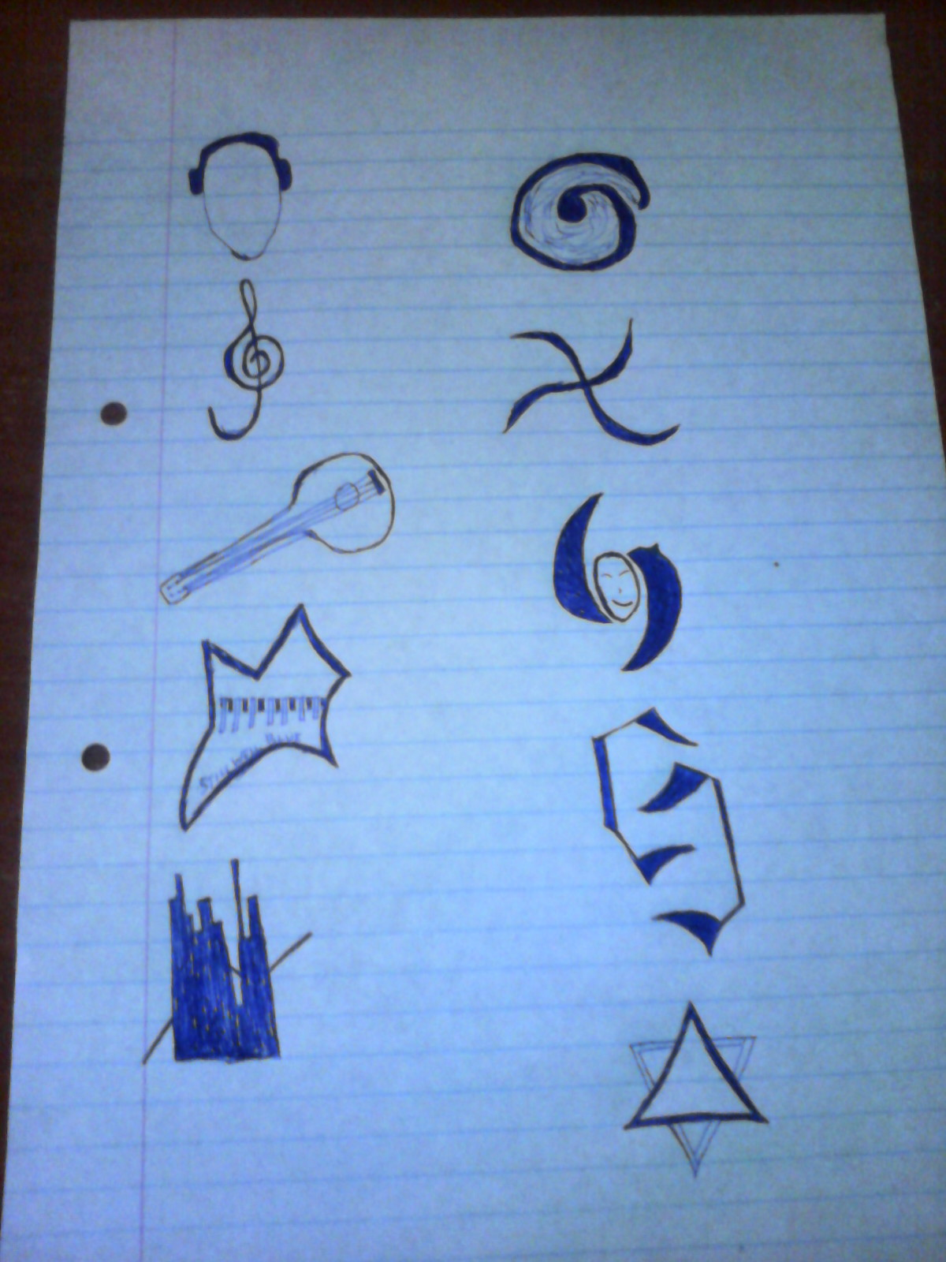
HAND DRAWN IMAGES

Slide 7
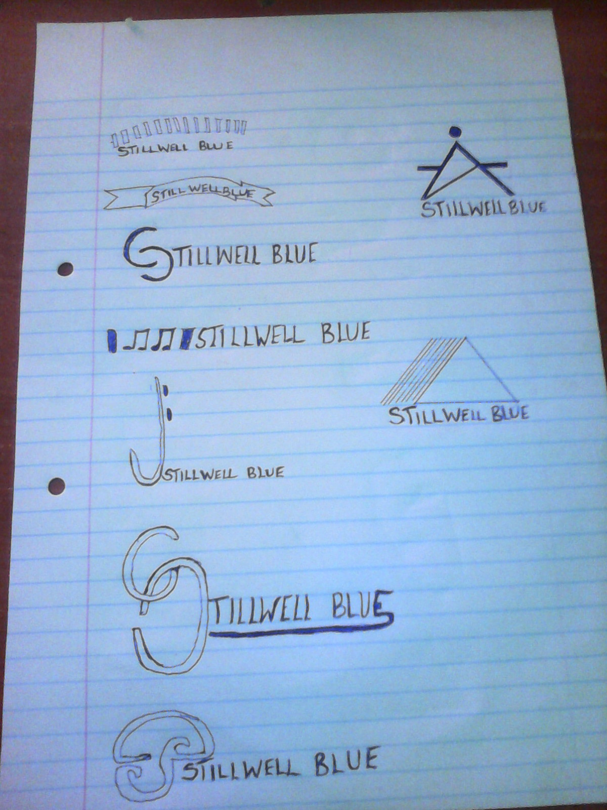
HAND DRAWN IMAGES

Slide 8

4 BY 4 300DPI LOGO 1

Slide 9

4 BY 4 300DPI LOGO 2

Slide 10

4 BY 4 300DPI LOGO 3

